Slide 1

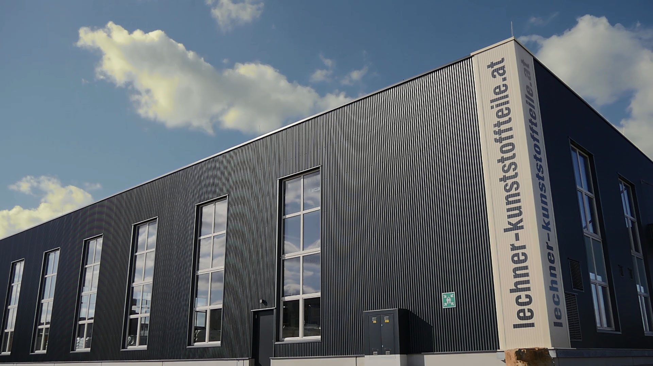
2022

Slide 2

CONTENT
History
Lechner Ges.m.b.H. – today
Technology
Services
CT-Scan Technologie on site
Lechner Ges.m.b.H. – 2022/23
01

Slide 3
HISTORY
Founder Hr. Christian Lechner
Founding of the company
Moved to the current location in Bad Vöslau
Warehouse expansion by 500 pallets
2008 Machinery expansion to 400 tons
02

Slide 4

HISTORY
Production-/Warehouse expansion, and machinery expansion to 800 tons
2017 Acquisition of 4 further injection molding machines (160 to 300 tons)
Production hall 2
03

Slide 5
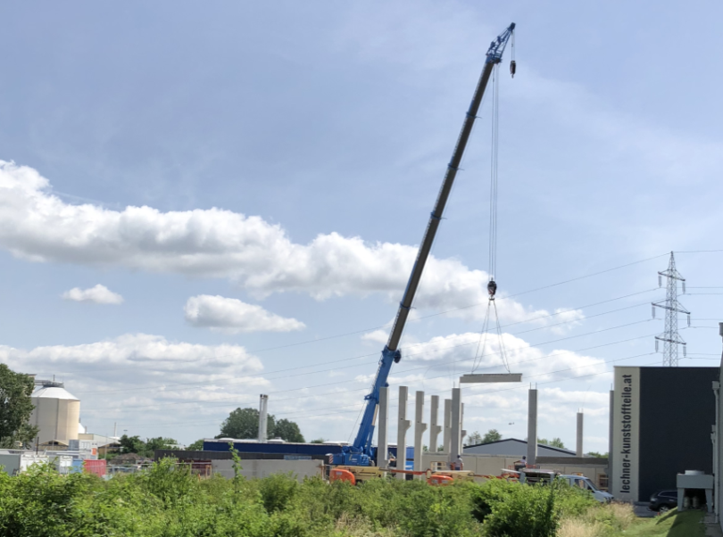
HISTORY
2018 Production-/Warehouse
expansion by 600m²
Machinery expansion
• 1000 tons clamping force
• for part weights up to 6kg
2021 Warehouse expansion by 2000m²
Warehouse construction 2018
04

Slide 6
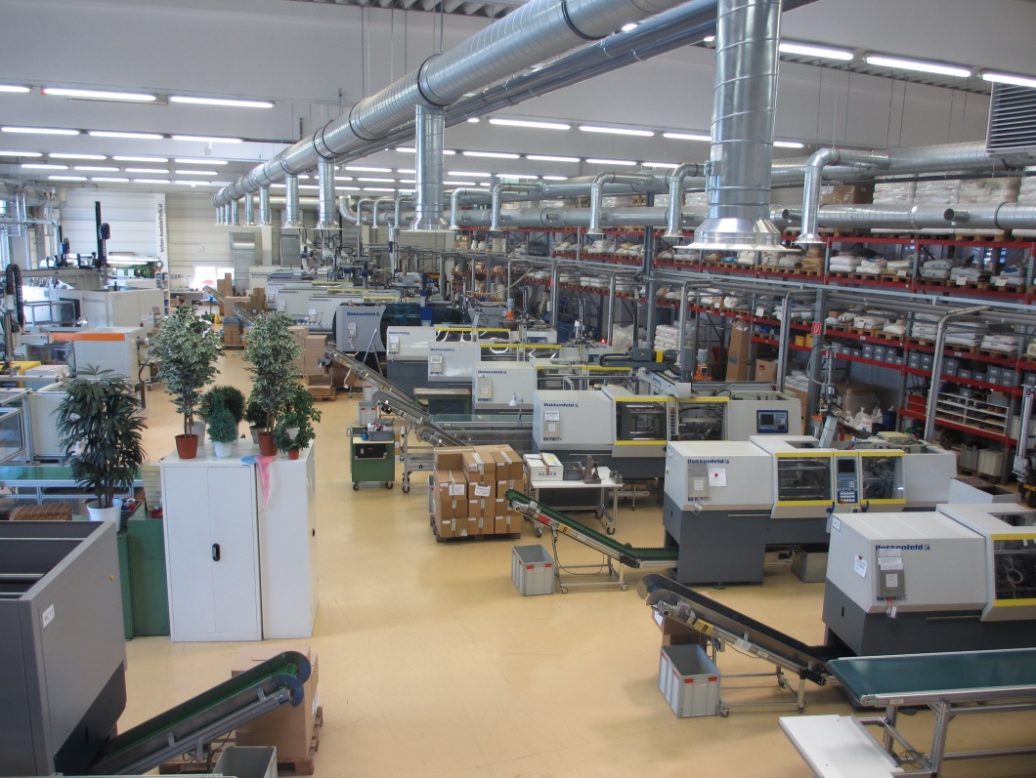
Today
TODAY:
180 different clients
  Electronics, Automotive
  Food packaging
  and many more….
3&4 - shifts
Production Area: 7000m²
Production
05

Slide 7
Today
34 injection molding machines
CLAMPING FORCE RANGE:
35 bis 1100 tons
PRODUCTION OF:
Prototypes and series
(10 pcs. – 400 Mio pcs/year)
PART WEIGHTS:
0,3 - 9000g
MATERIAL:
  Thermoplastics
  PP, PA, PC, TPE, …
Production
06

Slide 8
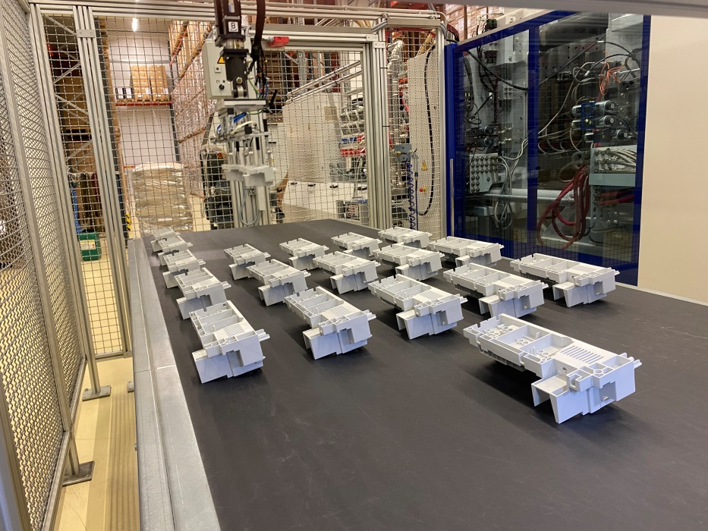
Today
Machine equipment
Core puls
Air valves
Automated handling-system
Cooling and heating-system
Cooling lines
Packaging machines
Integrated laser marking
in the molding process
07

Slide 9
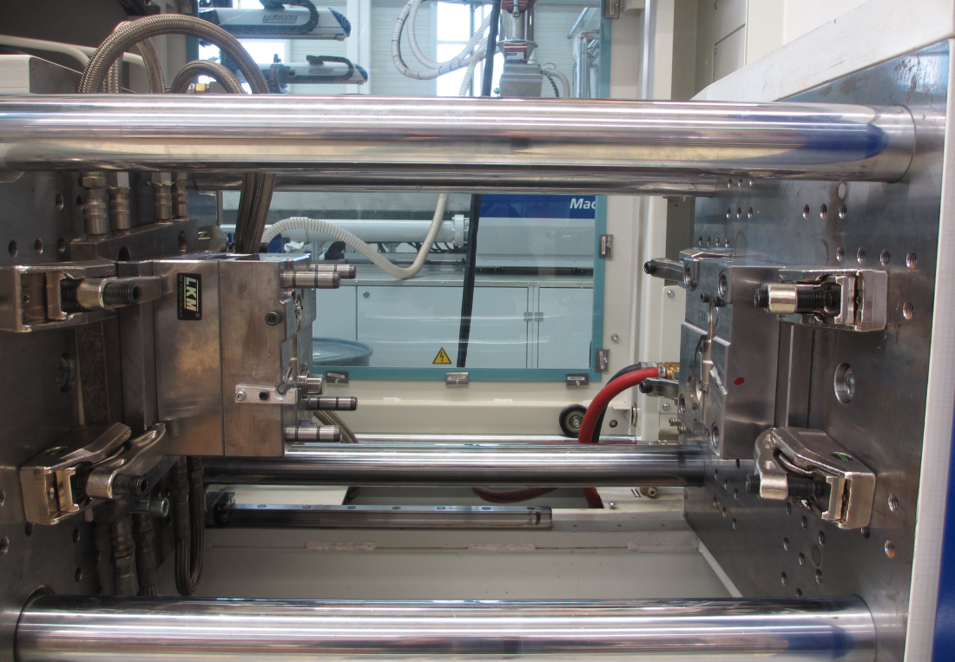
Today
ISO 9001-2015 certified
RECORDING OF:
temperature
pressure
time
dimensional checks
80 t injection molding machines
08

Slide 10
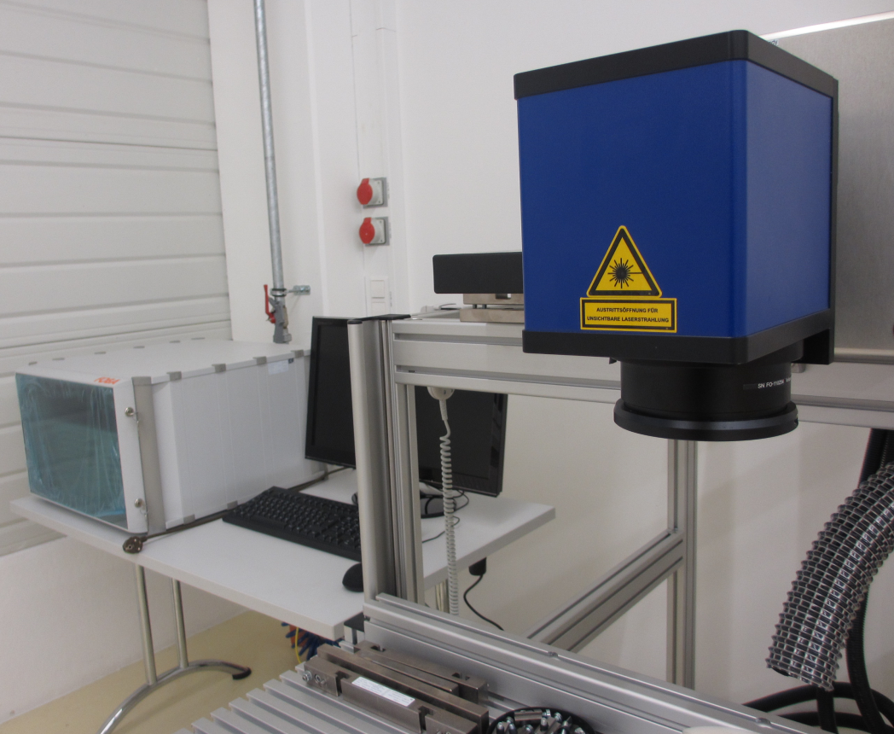
TECHNOLOGY
AT OUR FACTORY
1k & 2K-injection moulding
Laser marking
Tampon printing
Ultrasonic-welding
Plastic-welding
assembling
Laser-welding (metal)
Turning, milling, eroding, surface grinding,
wire cutting
UV-Laser
09

Slide 11
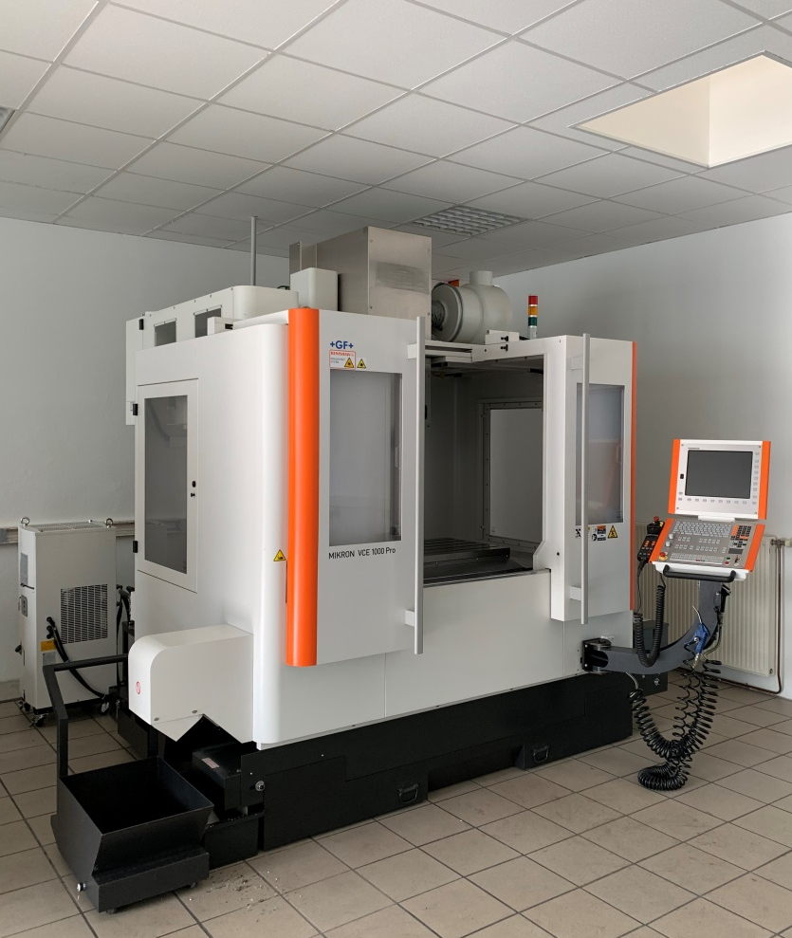
ADDITIONAL SERVICES
MOULDS
Service
repair
store
organization of new tools
Milling machine Micron 1000 Pro
10

Slide 12
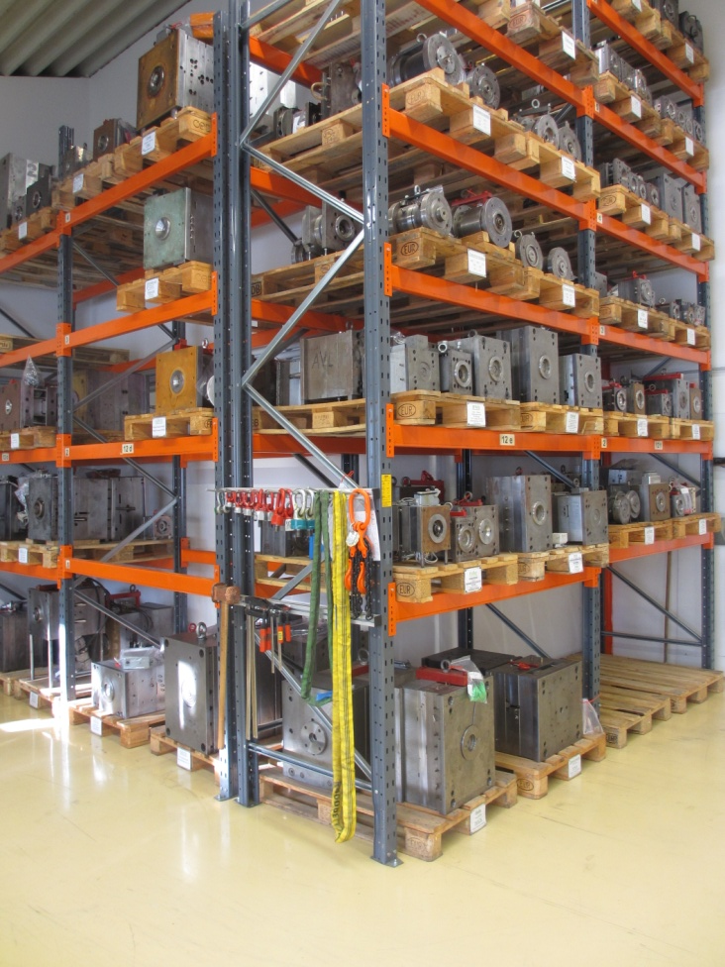
ADDITIONAL SERVICES
TOOL ORGANIZATION
Over valued partners in Austria
Tool-storage
11

Slide 13
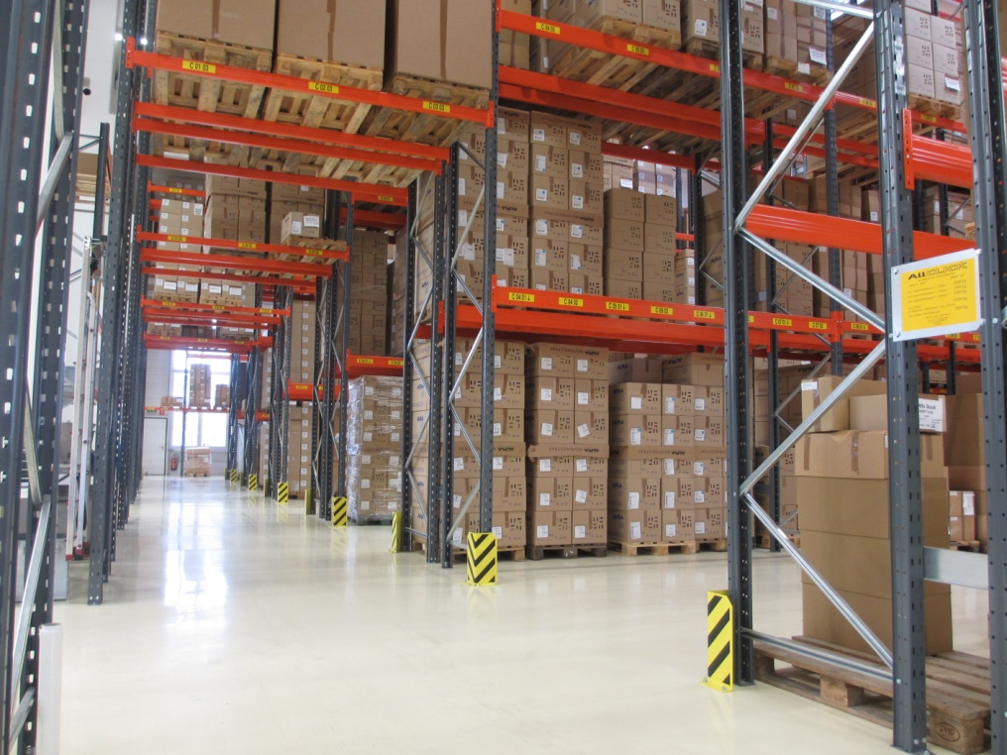
ADDITIONAL SERVICES
STOCK FOR PARTS
3200 m²
2800 EUR- Palettes
OPTION
storage at Lechner
Immediate delivery when ordered
Stock for goods
12

Slide 14
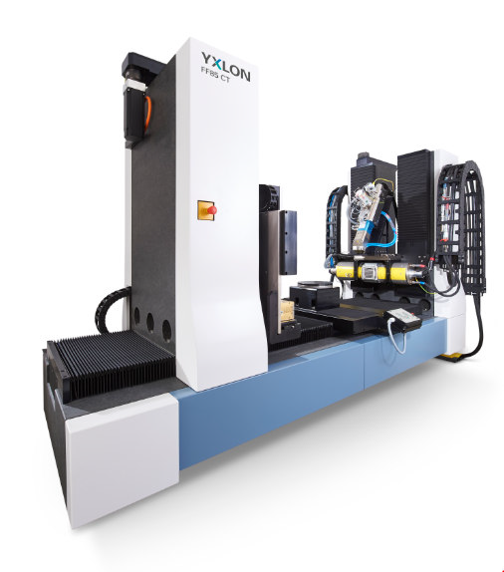
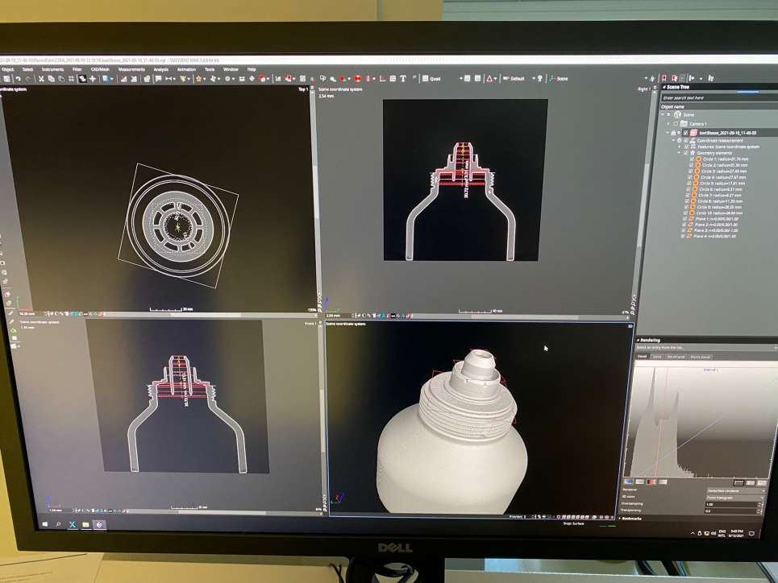
CT-SCAN
Start of computed tomography in 2021
in our quality control
Scan size up to: Ø730mmx950mm
Complete X-ray, digitizing and measuring of plastic parts and full assemblies without destruction
Assessment of parts inner workings
Pore ​​analysis, .Step data creation
Target/actual 3D comparisons, and much more...
CT-System
CT result: 3D, 2D with layered view
13

Slide 15
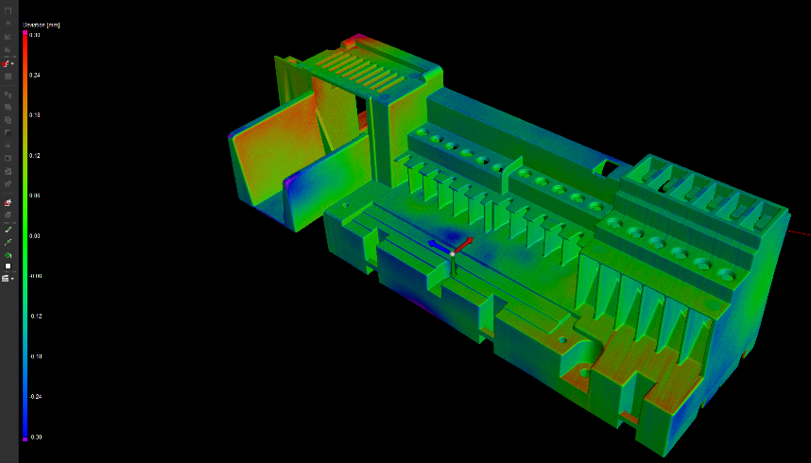
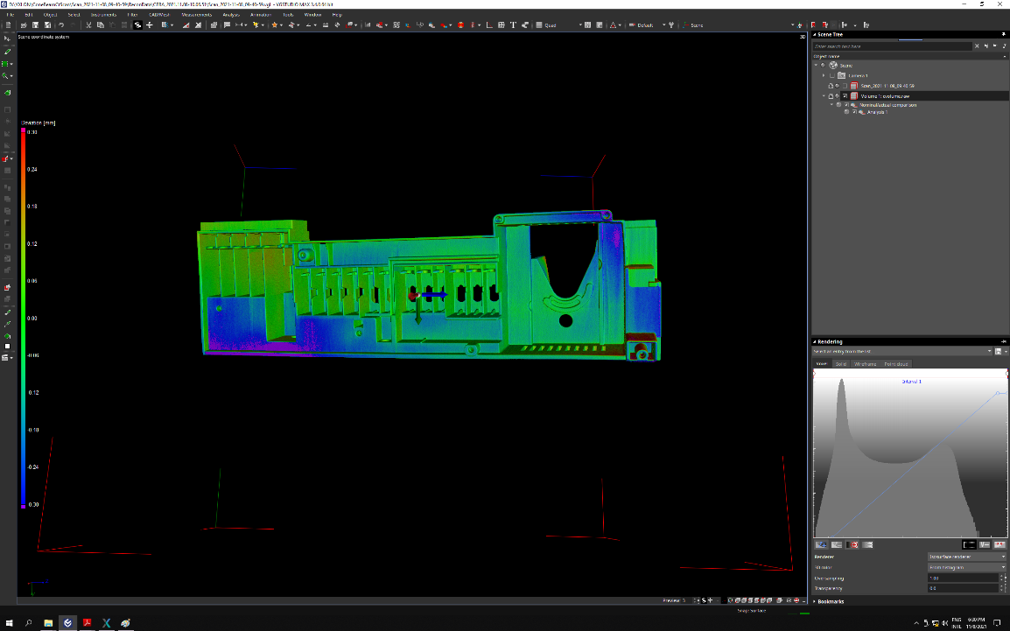
CT-SCAN
Start of computed tomography 2021
in our quality assurance
possible scan size: Ø730mmx950mm
Complete X-ray, digitizing and measuring of plastic parts and assemblies
Assessment of parts inner workings
Pore ​​analysis, .Step data creation
Target/actual 3D comparisons, and much more...
Flat target/actual comparison
14

Slide 16
FUTURE
PLANS FOR 2022/23:
Expansion of computed tomography and making use of all the possibilities
Start thermoforming up to a base area
to 756x565mm
Expansion of large machine park
continue trends
  organic growth
  machine purchases
  create more storage space
  Investments according to customer requirements
15

Slide 17
THANK YOU FOR YOUR ATTENTION
GRADUATION
For more information visit us at:
www.lechner-kunststoffteile.at
Hr. Bernhard Lechner
bl@lechner-kunststoffteile.at
16

